Slide 1
Definitions and RNA review
measure transcriptomes – mainly by cDNA sequencing – known as RNA-seq
- other transcriptome methods – micro-arrays
__Basics of ChIP as a way to map DNA-bound or associated proteins (TFs, transcription factors, histones, co-activators and co-repressors etc).
RNA-seq

Slide 2
The transcriptome and ways to measure it
Complete set of transcripts in a cell, tissue or animal.
Includes:
Protien coding transcripts, mRNA
many measurements focus on mature mRNA, but precursor transcripts are also part of the transcriptome
Non-coding Transcripts e.g. lincRNA, siRNA, miRNA
rRNA, tRNA (>90% of total RNA)
In aggregate, dictates the activities of a cell. No RNA-> no protein!
Learning transcriptome content is an integral part of most functional genomics studies; can help explain impact of mutations in regulatory pathways and in cis-elements.

Slide 3
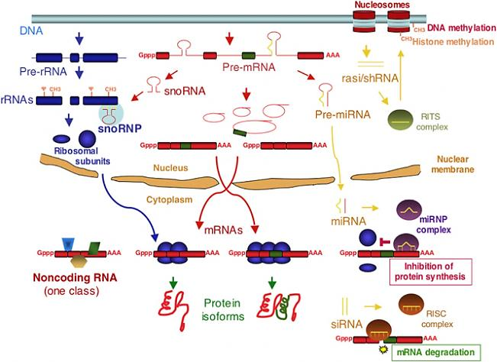
RNA components – reminders re their biogenesis
(Soares, 2006)
Notes:
the non-coding RNA class is likely to be quite heterogeneous. Some will be unimportant “noise” transcription. Others are regulatory, and the number of mechanisms and pathways by which operate, in cis and in trans are objects of active study. X inactivation role for XIST and TSIX are more advanced and will be discussed.

Slide 4
Transcriptomics
For a cell or tissue, transcriptome study includes:
identify specific RNAs
characterize their structure
quantify variation with cell type, treatment, growth, development etc
Main overall use Big picture:
What genes are expressed? (associated with why?)
Which genes are differentially expressed? (why? and
with what effect on cell and organism)

Slide 5
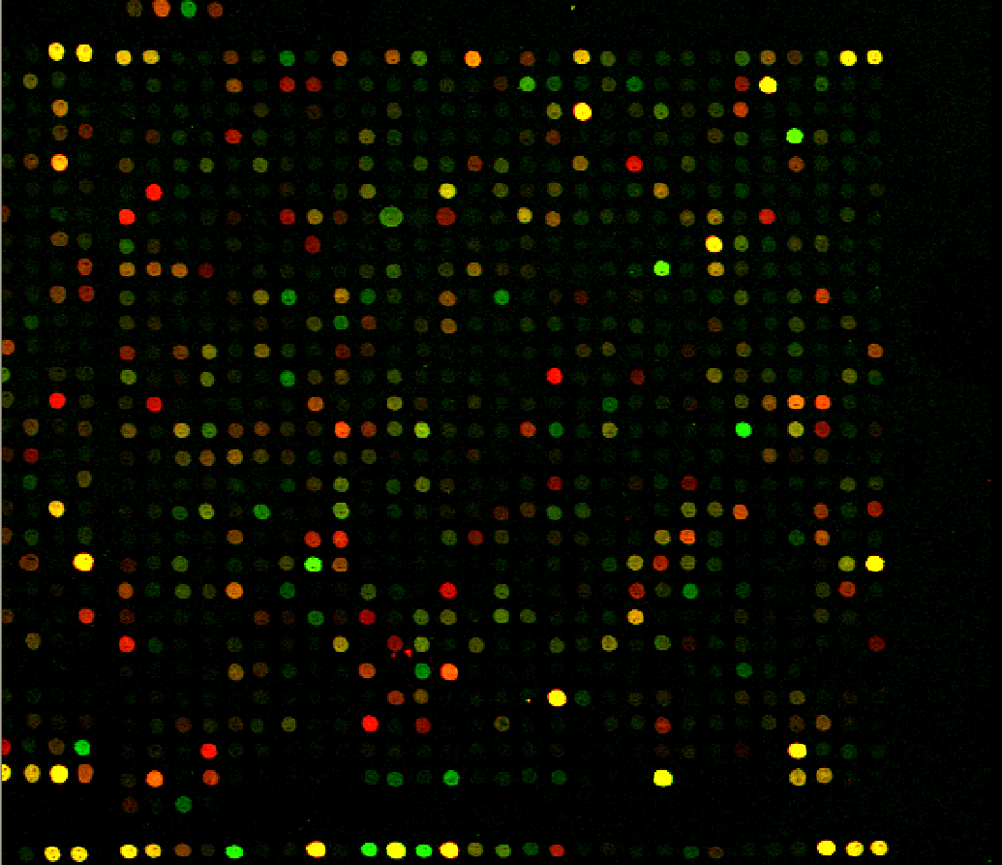
Ways to measure transcriptomes
Microarrays are one powerful way to measure RNA globally
Main technique used for genome-wide assays for about 10 years. Still used.
Based on hybridization to pre-selected probes.
Lots of important papers and biology use these data
But......
Limited dynamic range compared to RNA-seq.
High background noise compared to RNA-seq.
Lower reproducibility rate than RNA-seq.
http://www.microarray.org/sfgf/

Slide 6
Technologies for transcriptomics
RNA-seq:
A direct method for ultra-high-throughput sequencing of cDNA using millions of reads.

Slide 7
Applications of RNA-seq
Quantification of gene expression.
Discovery and quantification of gene isoforms.
Discovery of unannotated genes in genomes.
Discovery of mutations.
Discovery of allele-specific expression.
RNA editing.

Slide 8
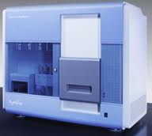
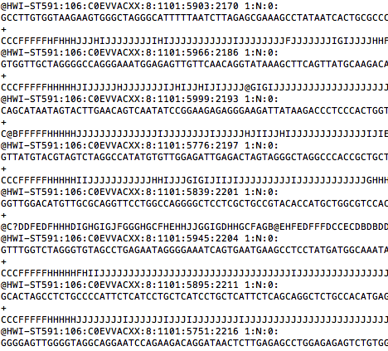
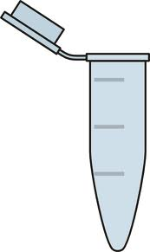

Oversimple Overview of RNA-seq
Cell/tissue
RNA
Sequencer
RNA-seq reads

Slide 9
Basic outline of long RNA-seq protocol
AAA
AAA
AAA
AAA
AAA
AAA
2X Poly(A)
selection
AAA
AAA
AAA
AAA
AAA
AAA
Fragmentation and
Reverse transcription
Sequencing,
mapping
Quantitation
3X
2X
1X

Slide 10
Overview of RNA-seq data analysis
RNA-seq
reads
Gene annotations
Reference genome
Mapping of reads
Quantitation
Differential expression

Slide 11
Overview of RNA-seq data analysis
No genome
RNA-seq
reads
de novo assembly
Gene annotations
Reference genome
Mapping of reads
Transcriptome
Quantitation
Differential expression

Slide 12
Overview of RNA-seq data analysis
No genome
RNA-seq
reads
de novo assembly
Gene annotations
Reference genome
Mapping of reads
ab initio assembly
Transcriptome
With genome
Quantitation
Differential expression

Slide 13
Computational challenges posed by RNA-seq
mapping “short” sequence reads to genome (as small as 25NT –now more usually = 50-125NT)
map reads across splice junctions (highly informative)
computational transcript assembly – possible, but isoforms make it challenging- more isoforms, more confusion
More difficult in large, complex (mammalian)genomes due to orthologs, repeats, and pseudo-genes.
These elements make correct read mapping harder

Slide 14
Uneven coverage levels
Transcript coverage levels differ along their lengths depending on library construction procedure.
Fragmentation before or after reverse transcription.
mRNA
Exon
Exon
Exon
Sequencing
mRNA
Exon
Exon
Exon

Slide 15
Sequencing bias
GC-rich and GC-poor regions are under-sampled during sequencing by some chemistries (e.g. Illumina).
Random priming causes bias against common hexamer e.g. (AAAAAA).
Not so random priming.
mRNA
ATCTTAAATATCGTCTGACTGACTGTCGTACGCGGCCCTATCGTACGTCGT
GC-poor
GC-rich

Slide 16
What follows is useful for the

Slide 17
Sequencing considerations
Amount of sequence:
20-40 million reads for RNA-seq quantitation.
More for transcript assembly.
Type of sequence:
Single-end, 1x50-100bp for quantitation.
Paired-end, 2x75bp or 2x100bp for RNA-seq transcriptome assembly.
Longer reads:
For RNA-seq, longer reads translate into more splice events observed. Clarity about long-range isoforms
increases with length of contiguous sequence read
The problem will be solved, ultimately, by full-length cDNA captured in one long continuous sequence

Slide 18
Read mapping considerations – do not have to do it-
do want you to think about it
Quality of sequence:
“Filtering by mapping” for quantitation.
Map using quality score for more sensitivity and for SNP-calling.
How to handle and weight multi-reads, i.e. reads that map to more than one place in the genome:
Ignore them. (dangerous, but sometimes useful to look at)
Take reads that map to a small number of places and allocate.
Take all.
How many mismatches to allow? Will this be used for SNP calling?
A finite number (e.g. 5/100)
A finite amount of quality budget ( e.g. up to 200 quality values, distributed across as many positions).
As many mismatches as still uniquely mappable.

Slide 19
Mapping RNA-seq reads
Mapping reads:
determine position of a read within the reference genome
“Read mapping” task:
Millions to billions of short reads.
How to cope with reads from repetitive regions.
Deal with sequencing error – different kinds of
platforms will give different amount and type of error

Slide 20
Spliced and unspliced reads
XX
pre-mRNA
Exon
Intron
Exon
Intron
Exon
RNA processing
mRNA
Exon
Exon
Exon
Sequencing,
read mapping
Spliced read
Unspliced read
mRNA
Exon
Exon
Exon

Slide 21
Mapping strategies
XX
Unspliced-read mapping
Spliced-read mapping
X
X
Exon A
Exon B
Exon C
Exon A
Exon B
Exon C
X
Non-aligned read
Intron-spanning read
Aligned read
Aligned read

Slide 22
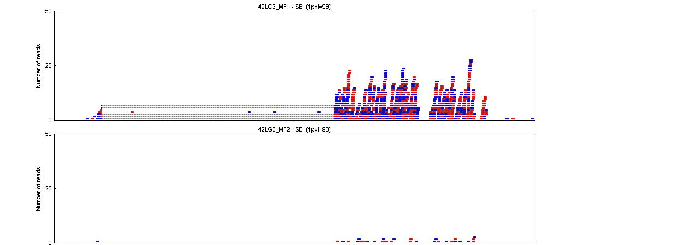
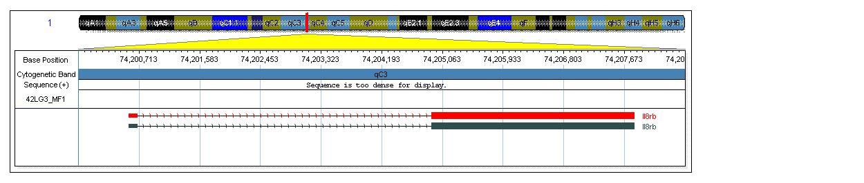
The Intuitive Beauty of RNA-Seq Data
+ SARS
547 Counts
- SARS
30 Counts

Slide 23
Quantitation of gene expression (sneaky case to show)
XX
Number of mapped reads a direct way to quantitate gene expression.
Different read densities
Different cell lines

Slide 24
Quantitation of transcript expression
XX
Given a set of
transcripts and
mapped reads,
determine transcript
Expression levels.
Coverage
Isoform A
Isoform B
Genome

Slide 25

RPKM Reads Per Kilobase of exon per Million reads
XX
Where N = Total reads mapped
L = Length of region
Genome
Gene A
mRNALength = 1000 bp
Gene B
mRNA Length = 1500 bp
Assuming 1
million reads mapped
RPKM = 10/1kb = 10
RPKM = 15/1.5kb = 10
If paired-end reads, then Fragments Per Kilobase per Million of mapped reads (FPKM)

Slide 26
Differential expression
Goal: To determine the set of differentially expressed genes, transcripts between two conditions or cell/tissue types
Approach:
Determine gene, transcript abundances.
Test for differentially expressed genes and transcripts e.g. test for statistical significance of differences between the expression level of genes from different conditions, time points.

Slide 27
Differential transcript expression
XX
We want to determine differential expression at the transcript level. Consider coverage shown:
Test for
differential
expression
Condition 1
coverage
Condition 2
coverage
Isoform A
Isoform B
Genome

Slide 28
Differential transcript expression
Test for differential expression based on counts:
at gene level and at exon level.
harder to do at transcript level: Uneveness of coverage
confuses! BUT splice-crossing reads help
Some relatively current tools designed for transcript level quantitation:
Cuffdiff (Trapnell, 2010)
eXpress (Roberts, submitted)
FluxCapacitator (Montgomery, 2010)

Slide 29
Differential transcript expression
XX
Want to determine differential expression at the transcript level. Total reads assigned each exon: attention to
unique exons
Then find & quantify junction-spanning reads to help with isoforms
Proportion of unique junction types can help sort assignment of
common exon reads to each form
Test for
differential
expression
Condition 1
coverage
Condition 2
coverage
Isoform A
Isoform B
Genome

Slide 30
Frame of reference: Super simplified CRM cartoon & model for enhancer
RNA coding Sequence
exon
intron
exon
OFF
Regulatory DNA (CRM = cis-acting reg module)
Specifies where & when RNA is made
Regulatory proteins
Protein machines make RNA
mRNA precursor
ON

Slide 31
Mapping TF Binding Sites Using
Chromatin Immunoprecipitation (ChIP)
Crosslink cells with formaldehyde and isolate nuclei
Sonicate
IP with specific antibody (or normal IgG)
Label and hybridize to microarray
Prepare library
and sequence
Reverse crosslinks

Slide 32
Genomewide Chromatin Immunoprecipitation: ChIP
Crosslink proteins to
DNA In vivo
Physically separate IP DNA
Shear fixed chromatin by
sonication
Identify bound DNA
Immunoprecipitate to enrich factor of interest
sequence DNA (5-20 million short reads)
2. map to genome
3. do the arithmetic & stats

Slide 33
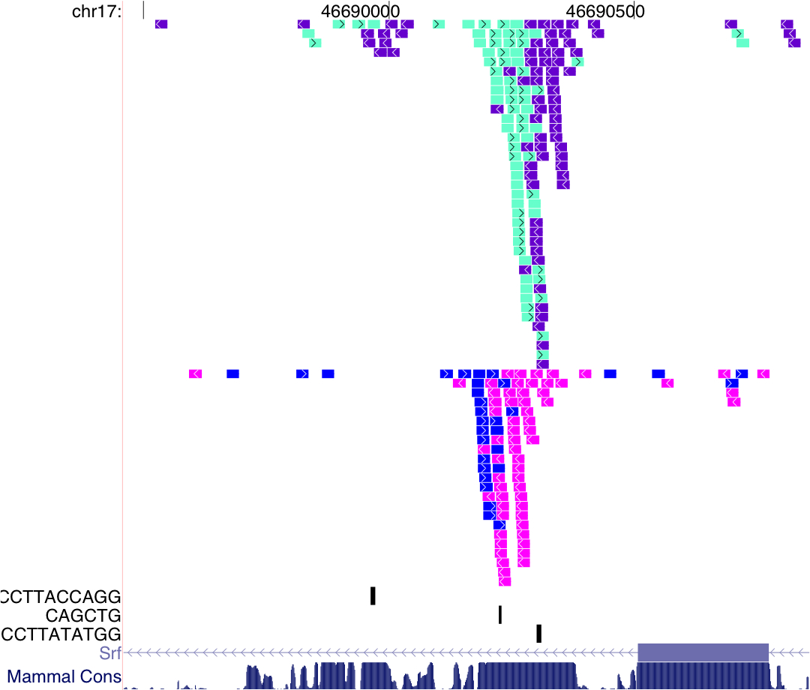
SRF locus Real primary read map data (at an interesting candidate auto-regulatory CRM, though that is not the main point here)
SRF
factor
MyoD
factor
binding
motifs

Slide 34
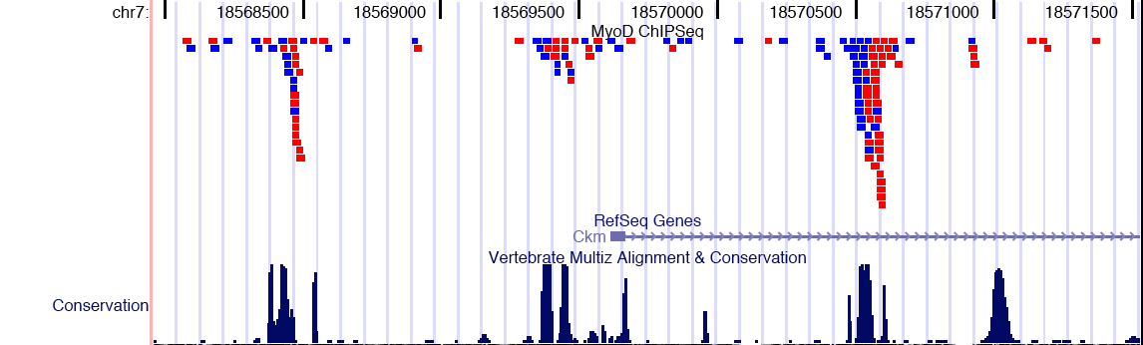
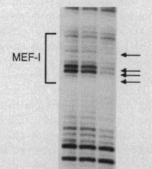
In vivo factor binding assayed across mouse genome
Previously known New from global data
“Classic” upstream
muscle enhancer
Muscle Promoter
Intron 1 candidate
Enhancer
Compare with in vivo footprints
Note CACCTG

Slide 35
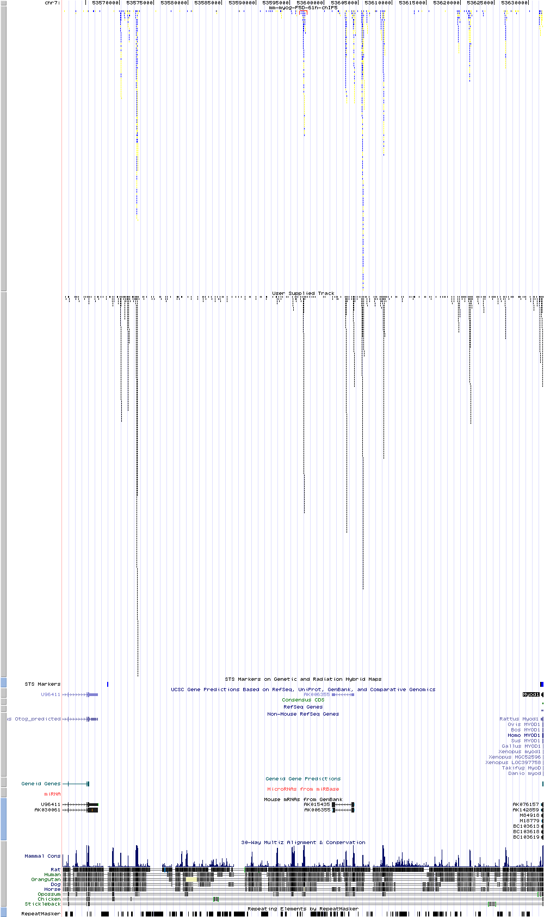
MyoD locus (~80kb): Basis for autoregulation and cross-regulation 12 regions - not 2
MyoD
Binding
early
Myogenin
Binding
late
Conservation
Small conserved regions correspond to each binding domain

Slide 36
Browser shot example of multiple kinds of ChIPseq emasurements: integrated view possible
Notes:
The functional correlates of different single and combination histone modifications will be addressed in a later talk. The point is that some preferentially markactive enhancers and/or promoters. Others mark domain that are repressed (including association with DNA methylation enzymes)

Slide 38
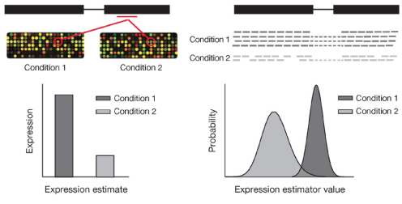
Previous tools and approaches
RNA-seq measurement of gene expression is discrete in contrast to continuous intensity distribution of microarrays. Background noise issues differ.
Microarray
RNA-seq
(Garber, 2011)
Therefore, statistical methods developed for microarrays are not directly applicable to RNA-seq analysis without modifications.

Slide 39
Parametric statistical approach
A parametric approach will:
model the distribution of the read counts by using a known probability distribution e.g. Poisson, negative binomial etc.
estimate the variance from the local and common dispersions of the genes in the samples.
determine differentially expressed genes by calculating p-values and false discovery rates.

Slide 40
Replication
Biological replicates ARE needed to correctly estimate the common and gene-wise dispersions in samples.
Biological replication controls false discovery rate.
It is safer to draw conclusions from data in the presence of biological replicates.
Technical replication alone not as important for RNA-seq analysis since protocols and sequencing platforms have high reproducibility.
Technical replicates are critical when samples are sequenced on different platforms.

Slide 41
Statistical framework for RNA-seq
Simplest approach: many reads (most often >20 million) and low probability of mapping to a gene points to Poisson model.
Poisson model:
variance is equal to the mean.
Negative binomial (NB) model:
variance is higher than mean.
NB a better model for differential expression when biological replicates are present:
Differentially expressed genes cause dispersion in expression.

